Slide 1
Digital Security and Forensics AICT006-4-2-DSF Version 2
Digital Forensic

Slide 2
Topics & Structure of The Lesson
Describe the Digital Forensic Science
Discuss Role of Computer Forensic
Discuss Role of Forensic Scientist
Discuss different Processes in Digital Forensic
Computer Investigations

Slide 3
Learning Outcome
At the end of this topic, You should be able to:
Describe the Computer Forensic
Discuss different Processes of Computer Forensic
Discuss the Computer Investigations

Slide 4
Key Terms You Must Be Able To Use
If you have mastered this topic, you should be able to use the following terms correctly in your assignments and exams:
Computer Forensic
Acquisition
Construction Analysis
Documentation

Slide 5
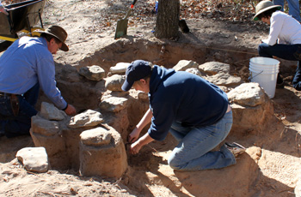
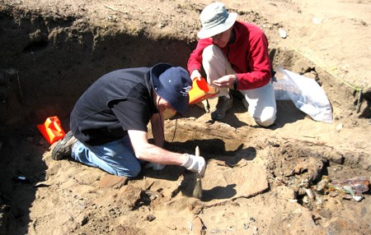
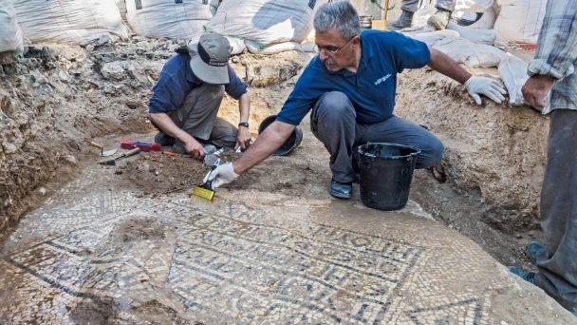
Digital Forensic
Digital forensics is a forensic science branch that involves the recovery, analysis, and preservation of any information found on digital devices.
Similar to archeologists to find facts through clueless artifacts found from digging sites.

Slide 6
Digital Forensics
This forensics branch often concerns cybercrimes. The term “digital forensics” was originally used as a synonym for computer forensics but has now expanded to cover the analysis of information on all devices that can store digital data.
Digital forensics experts react to incidents like server hacks or leaks of sensitive information. Their specialized forensic toolkits help them investigate incidents, analyze traffic, and look for hidden data and other evidence. They collect, recover, and store the data relevant for the investigation and prepare and present it in court.
Depending on the type of information and its sources, digital forensics has branches and requires specific professional training that gives excellent career prospects and exciting occupations.

Slide 7
Digital Forensics
Also known as Computer Forensics.
Digital Forensics is the preservation, identification, extraction, interpretation, and documentation of computer evidence that can be used in the court of law.
A system in your enterprise has been compromised.
Can be as simple as retrieving a single piece of data.
Can be as complex a piecing together a trail of many digital artifacts.
You want to track down suspicious activity. Where do you begin?
Defined
Pertains to legal evidence found in computers and digital storage mediums.
Goal
To Explain the current state of a “digital artifact”.
Digital Artifact
Is a computer system, storage media (such as a hard disk or CDROM), an electronic document (e.g., an email message or JPEG image), or even a sequence of packets moving over a computer network.

Slide 8
Why Use Digital Forensics?
1. Legal Cases
Computer forensic techniques are frequently used to analyze computer systems belonging to defendants (in criminal cases) or litigants (in civil cases).
2. Recover Data
To recover data in the event of a hardware or software failure.
3. Analyze
To analyze a computer system after a break-in, i.e., to determine how the attacker gained access and what the attacker did.
4. Gather Evidence
To gather evidence against an employee that an organization wishes to terminate.
5. Gain Information
To gain information about how computer systems work for the purpose of debugging, performance optimization, or reverse-engineering.

Slide 9
Chain of Custody
“Chain of custody” is a fancy way of saying “The ability to demonstrate who has had access to digital information being used as evidence”.
Special measures should be taken when conducting a forensic investigation if it is desired for the results to be used in a court law.
One of the most important measures is to assure that the evidence has been accurately collected and that there is a clear chain of custody from the scene of the crime to the investigator → and ultimately to the court

Slide 10
Type Of Digital Evidences
Digital evidence is any sort of data stored and collected from any electronic storage device. Digital evidence can also be retrieved from wireless networks and random-access memory. There are many types of electronic evidence and methodologies of their retrieval, storage, and analysis. The types of electronic evidence include but are not limited to the following examples:
1
Media files (photo, video, audio)
6
Databases
11
Records from networking devices
Hidden and encrypted data
16
2
User account data
7
Accounting program files
12
ATM transaction logs
17
Printer, fax, and copy machine logs
3
Emails
8
Windows registry system files
13
GPS logs
Computer backups
18
4
Web browser history
9
RAM system files
14
Electronic door logs
5
Phone calls
10
Any type of digital files
15
CCTV cameras records

Slide 11
Branches Of Digital Forensics
Digital forensics is a fast-growing scientific discipline. It evolves in response to the tremendous development of technology. At the current stage, digital forensics has its branches specializing in narrow fields.
The names of the different branches speak to the different areas which they focus on.
Computer Forensics
4
Forensic Data Analysis
7
Malware Forensics
1
Mobile Device Forensics
5
Database Forensics
8
Memory Forensics
10
Disk
Forensics
2
3
Mobile Device Forensics
6
Email Forensics
9
Wireless Forensics

Slide 12
Branches Of Digital Forensics
Computer Forensics
Computer forensics provides the collection, identification, preservation, and analysis of data from personal computers, laptops, and storage computing devices.
1
Mobile Device Forensics
Specialists in this branch can retrieve data from smartphones, SIM cards, mobile phones, GPS devices, tablets, PDAs, and game consoles.
This type of analysis is required to retrieve audio and visual data, contacts, and call logs from the devices presented in court as evidence.
2
Mobile Device Forensics
Network forensics aims to monitor, register, and analyze any network activity.
The network specialists analyze traffic and activity in case of security breaches, cyberattacks, and other incidents in cyberspace.
3
4
Forensic Data Analysis
This branch of forensics analyzes structured data.
The data analysts are mainly involved in investigating financial crimes and fraud..
Database Forensics
Database forensic specialists investigate any access to a database and report any changes made in the data.
Database forensics can be used to verify commercial contracts and to investigate large-scale financial crimes.
5

Slide 13
Branches Of Digital Forensics
Email Forensics
Email forensics analysts retrieve relevant data from email. This information can be the senders’ and receivers’ identities, the content of the messages, time stamps, sources, and metadata.
Email forensics tools are widely used when a company is suspected of email forgery.
6
Malware Forensics
The specialists in this branch detect, analyze, and investigate different malware types to trace suspects and reasons for the attack. They also evaluate the damage caused by the attack and determine the code of the malware.
7
Memory Forensics
This type of digital forensics is also called live acquisition. It retrieves the data from RAM. The recent development in cybercrime technology enables hackers to leave no traces on hard drives. In such cases, memory forensics helps to track down the attack.
8
Wireless Forensics
Wireless forensics uses specific tools and methodologies to analyze and investigate traffic in a wireless environment.
This type of analysis is crucial when computer crimes or cyberattacks are committed through the breach of security protocols in wireless networks.
9
Disk
Forensics
Specialists in disk forensics retrieve and recover data from hard drives and other physical storage devices, such as memory cards, servers, flash drives, and external USB sticks.
Disk forensics analysts make sure any data relevant to the case is recovered, analyzed, and presented as evidence.
10

Slide 14
The Benefits of Digital Forensics
Digital Forensics help to protect from and solve cases involving:
Theft of Intellectual Property
This pertains to any act that allows access to patient trade secrets, customer data, and any confidential information.
1
Financial Fraud
This pertains to anything that uses fraudulent solicitation of victims’ information to conduct fraudulent transactions.
2
Hacker System Penetration
Taking advantage of vulnerabilities of systems or software using tools such as rootkits and sniffers.
3
Distribution and execution of viruses and worms
These are the most common forms of cybercrime and often cost the most damage.
4

Slide 15
Digital Forensics Process
Identification
The first stage implies the identification of investigation goals and required resources. The analysts also identify the evidence, the type of data they deal with, and the devices the data is stored on. Digital forensics specialists work with all kinds of electronic storage devices: hard drives, mobile phones, personal computers, tablets, etc.
1
Preservation
At this stage, analysts ensure that the data is isolated and preserved. Usually, it means that no one can use the device until the end of the investigation, so the evidence remains secure.
2
Analysis
The analysis stage includes a deep systematic search for any relevant evidence. The specialists work with both system and user files and data objects. Based on the found evidence, the analysts draw conclusions.
3
Documentation
At this stage, all the found relevant evidence is documented. It helps to extend the crime scene and prompts investigation. Any digital evidence is recorded together with the photos, sketches, and crime scene mapping.
4
Reporting
At the final stage, all evidence and conclusions are reported according to forensics protocols, which include the methodologies and procedures of the analysis and their explanation.
5

Slide 16
Digital Forensics Tools
At the early stages of digital forensics development, the specialists had a very limited choice of tools used to analyze digital evidence. It led to multiple allegations that such analysis might have caused evidence to be altered and corrupted. Inevitably, there emerged sophisticated tools designed specifically for digital forensics analysis.
Disk and data capture tools can detect encrypted data and capture and preview the information on physical drives;
File viewers and file analysis tools work to extract and analyze separate files;
Registry analysis tools get the information about a user and their activities from the Windows registry;
Internet and network analysis tools provide detailed information about traffic and monitor user’s activity on the Internet;
Email analysis tools are designed to scan email content;
Mobile device analysis tools help extract data from the internal and external memory of mobile devices;
Mac OS analysis tools retrieve metadata from Mac operating systems and provide disk imaging;
Database forensics tools can analyze and manipulate data and provide reports of activities performed.

Slide 17
Preparing a Computer Investigation

Slide 18
Preparing a Computer Investigation
Role of computer forensics professional is to gather evidence to prove that a suspect committed a crime or violated a company policy
Collect evidence that can be offered in court or at a corporate inquiry
Investigate the suspect’s computer
Preserve the evidence on a different computer

Slide 19
Preparing a Computer Investigation (continued)
Follow an accepted procedure to prepare a case
Chain of custody
Route the evidence takes from the time you find it until the case is closed or goes to court

Slide 20
An Overview of a Computer Crime
Computers can contain information that helps law enforcement determine:
Chain of events leading to a crime
Evidence that can lead to a conviction
Law enforcement officers should follow proper procedure when acquiring the evidence
Digital evidence can be easily altered by an overeager investigator
Information on hard disks might be password protected

Slide 21
An Overview of a Company Policy Violation
Employees misusing resources can cost companies millions of dollars
Misuse includes:
Surfing the Internet
Sending personal e-mails
Using company computers for personal tasks

Slide 22
Taking a Systematic Approach

Slide 23
Taking a Systematic Approach
Steps for problem solving
Make an initial assessment about the type of case you are investigating
Determine a preliminary design or approach to the case
Create a detailed checklist
Determine the resources you need
Obtain and copy an evidence disk drive

Slide 24
Taking a Systematic Approach (continued)
Steps for problem solving (continued)
Identify the risks
Mitigate or minimize the risks
Test the design
Analyze and recover the digital evidence
Investigate the data you recover
Complete the case report
Critique the case

Slide 25
Assessing the Case
Systematically outline the case details
Situation
Nature of the case
Specifics of the case
Type of evidence
Operating system
Known disk format
Location of evidence

Slide 26
Assessing the Case (continued)
Based on case details, you can determine the case requirements
Type of evidence
Computer forensics tools
Special operating systems

Slide 27
Planning Your Investigation
A basic investigation plan should include the following activities:
Acquire the evidence
Complete an evidence form and establish a chain of custody
Transport the evidence to a computer forensics lab
Secure evidence in an approved secure container

Slide 28
Planning Your Investigation (continued)
A basic investigation plan (continued):
Prepare a forensics workstation
Obtain the evidence from the secure container
Make a forensic copy of the evidence
Return the evidence to the secure container
Process the copied evidence with computer forensics tools

Slide 29
Planning Your Investigation (continued)
An evidence custody form helps you document what has been done with the original evidence and its forensics copies
Two types
Single-evidence form
Lists each piece of evidence on a separate page
Multi-evidence form

Slide 30
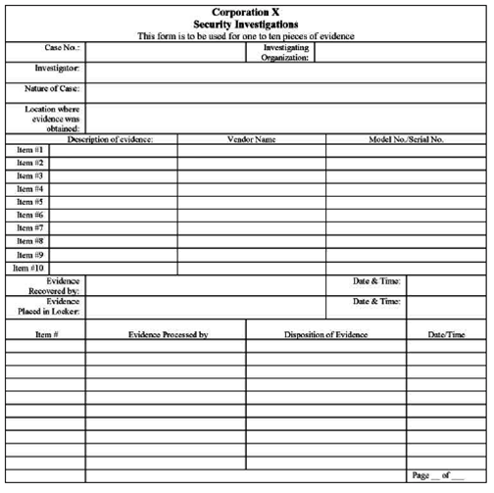
Planning Your Investigation (continued)

Slide 31
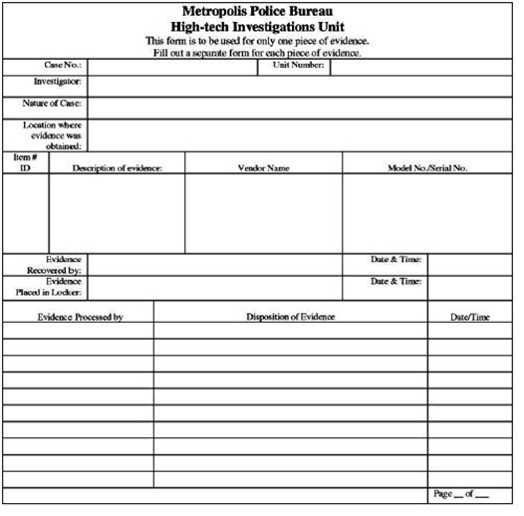
Planning Your Investigation (continued)

Slide 32
Securing Your Evidence
Use evidence bags to secure and catalog the evidence
Use computer safe products
Antistatic bags
Antistatic pads
Use well padded containers
Use evidence tape to seal all openings
Floppy disk or CD drives
Power supply electrical cord

Slide 33
Securing Your Evidence (continued)
Write your initials on tape to prove that evidence has not been tampered with
Consider computer specific temperature and humidity ranges

Slide 34
Procedures for Corporate High-Tech Investigations

Slide 35
Procedures for Corporate High-Tech Investigations
Develop formal procedures and informal checklists
To cover all issues important to high-tech investigations

Slide 36
Employee Termination Cases
Majority of investigative work for termination cases involves employee abuse of corporate assets
Internet abuse investigations
To conduct an investigation you need:
Organization’s Internet proxy server logs
Suspect computer’s IP address
Suspect computer’s disk drive
Your preferred computer forensics analysis tool

Slide 37
Employee Termination Cases (continued)
Internet abuse investigations (continued)
Recommended steps
Use standard forensic analysis techniques and procedures
Use appropriate tools to extract all Web page URL information
Contact the network firewall administrator and request a proxy server log
Compare the data recovered from forensic analysis to the proxy server log
Continue analyzing the computer’s disk drive data

Slide 38
Employee Termination Cases (continued)
E-mail abuse investigations
To conduct an investigation you need:
An electronic copy of the offending e-mail that contains message header data
If available, e-mail server log records
For e-mail systems that store users’ messages on a central server, access to the server
Access to the computer so that you can perform a forensic analysis on it
Your preferred computer forensics analysis tool

Slide 39
Employee Termination Cases (continued)
E-mail abuse investigations (continued)
Recommended steps
Use the standard forensic analysis techniques
Obtain an electronic copy of the suspect’s and victim’s e-mail folder or data
For Web-based e-mail investigations, use tools such as FTK’s Internet Keyword Search option to extract all related e-mail address information
Examine header data of all messages of interest to the investigation

Slide 40
Attorney-Client Privilege Investigations
Under attorney-client privilege (ACP) rules for an attorney
You must keep all findings confidential
Many attorneys like to have printouts of the data you have recovered
You need to persuade and educate many attorneys on how digital evidence can be viewed electronically
You can also encounter problems if you find data in the form of binary files

Slide 41
Attorney-Client Privilege Investigations (continued)
Steps for conducting an ACP case
Request a memorandum from the attorney directing you to start the investigation
Request a list of keywords of interest to the investigation
Initiate the investigation and analysis
For disk drive examinations, make two bit-stream images using different tools
Compare hash signatures on all files on the original and re-created disks

Slide 42
Attorney-Client Privilege Investigations (continued)
Steps for conducting an ACP case (continued)
Methodically examine every portion of the disk drive and extract all data
Run keyword searches on allocated and unallocated disk space
For Windows OSs, use specialty tools to analyze and extract data from the Registry
AccessData Registry Viewer
For binary data files such as CAD drawings, locate the correct software product
For unallocated data recovery, use a tool that removes or replaces nonprintable data

Slide 43
Attorney-Client Privilege Investigations (continued)
Steps for conducting an ACP case (continued)
Consolidate all recovered data from the evidence bit-stream image into folders and subfolders
Other guidelines
Minimize written communications with the attorney
Any documentation written to the attorney must contain a header stating that it’s “Privileged Legal Communication—Confidential Work Product”

Slide 44
Attorney-Client Privilege Investigations (continued)
Other guidelines (continued)
Assist attorney and paralegal in analyzing the data
If you have difficulty complying with the directions
Contact the attorney and explain the problem
Always keep an open line of verbal communication
If you’re communicating via e-mail, use encryption

Slide 45
Media Leak Investigations
In the corporate environment, controlling sensitive data can be difficult
Consider the following for media leak investigations
Examine e-mail
Examine Internet message boards
Examine proxy server logs
Examine known suspects’ workstations
Examine all company telephone records, looking for calls to the media

Slide 46
Media Leak Investigations (consider)
Steps to take for media leaks
Interview management privately
To get a list of employees who have direct knowledge of the sensitive data
Identify media source that published the information
Review company phone records
Obtain a list of keywords related to the media leak
Perform keyword searches on proxy and e-mail servers

Slide 47
Media Leak Investigations (consider)
Steps to take for media leaks (continued)
Discreetly conduct forensic disk acquisitions and analysis
From the forensic disk examinations, analyze all e-mail correspondence
And trace any sensitive messages to other people
Expand the discreet forensic disk acquisition and analysis
Consolidate and review your findings periodically
Routinely report findings to management

Slide 48
Industrial Espionage Investigations
All suspected industrial espionage cases should be treated as criminal investigations
Staff needed
Computing investigator who is responsible for disk forensic examinations
Technology specialist who is knowledgeable of the suspected compromised technical data
Network specialist who can perform log analysis and set up network sniffers
Threat assessment specialist (typically an attorney)

Slide 49
Industrial Espionage Investigations (continued)
Guidelines
Determine whether this investigation involves a possible industrial espionage incident
Consult with corporate attorneys and upper management
Determine what information is needed to substantiate the allegation
Generate a list of keywords for disk forensics and sniffer monitoring
List and collect resources for the investigation

Slide 50
Industrial Espionage Investigations (continued)
Guidelines (continued)
Determine goal and scope of the investigation
Initiate investigation after approval from management
Planning considerations
Examine all e-mail of suspected employees
Search Internet newsgroups or message boards
Initiate physical surveillance
Examine facility physical access logs for sensitive areas

Slide 51
Industrial Espionage Investigations (continued)
Planning considerations (continued)
Determine suspect location in relation to the vulnerable asset
Study the suspect’s work habits
Collect all incoming and outgoing phone logs
Steps
Gather all personnel assigned to the investigation and brief them on the plan
Gather resources to conduct the investigation

Slide 52
Industrial Espionage Investigations (continued)
Steps (continued)
Place surveillance systems
Discreetly gather any additional evidence
Collect all log data from networks and e-mail servers
Report regularly to management and corporate attorneys
Review the investigation’s scope with management and corporate attorneys

Slide 53
Interviews and Interrogations in High-Tech Investigations
Becoming a skilled interviewer and interrogator can take many years of experience
Interview
Usually conducted to collect information from a witness or suspect
About specific facts related to an investigation
Interrogation
Trying to get a suspect to confess

Slide 54
Interviews and Interrogations in High-Tech Investigations (continued)
Role as a computing investigator
To instruct the investigator conducting the interview on what questions to ask
And what the answers should be
Ingredients for a successful interview or interrogation
Being patient throughout the session
Repeating or rephrasing questions to zero in on specific facts from a reluctant witness or suspect
Being tenacious

Slide 55
Understanding Data Recovery Workstations and Software

Slide 56
Understanding Data Recovery Workstations and Software
Investigations are conducted on a computer forensics lab (or data-recovery lab)
Computer forensics and data-recovery are related but different
Computer forensics workstation
Specially configured personal computer
Loaded with additional bays and forensics software
To avoid altering the evidence use:
Forensics boot floppy disk OR cd
Write-blocker devices

Slide 57
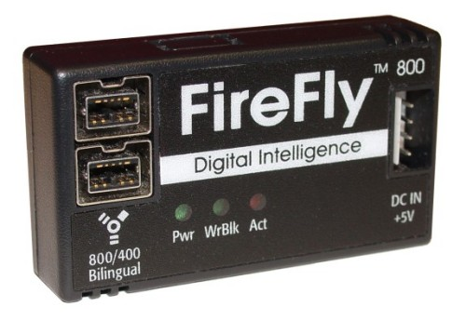
Write Blocker
Connects a hard drive in trusted read-only mode
There are also Linux boot CDs that mount all drives read-only, such as Helix and some Knoppix distributions

Slide 58
Setting Up Your Computer for Computer Forensics
Basic requirements
A workstation running Windows XP or Vista
A write-blocker device
Computer forensics acquisition tool
Like FTK Imager
Computer forensics analysis tool
Like FTK
Target drive to receive the source or suspect disk data
Spare PATA or SATA ports
USB ports

Slide 59
Setting Up Your Computer for Computer Forensics (continued)
Additional useful items
Network interface card (NIC)
Extra USB ports
FireWire 400/800 ports
SCSI card
Disk editor tool
Text editor tool
Graphics viewer program
Other specialized viewing tools

Slide 60
Conducting an Investigation

Slide 61
Conducting an Investigation
Gather resources identified in an investigation plan
Items needed
Original storage media
Evidence custody form
Evidence container for the storage media
Bit-stream imaging tool
Forensic workstation to copy and examine your evidence
Securable evidence locker, cabinet, or safe

Slide 62
Gathering the Evidence
Avoid damaging the evidence
Steps
Meet the IT manager to interview him
Fill out the evidence form, have the IT manager sign
Place the evidence in a secure container
Complete the evidence custody form
Carry the evidence to the computer forensics lab
Create forensics copies (if possible)
Secure evidence by locking the container

Slide 63
Understanding Bit-Stream Copies
Bit-stream copy
Bit-by-bit copy of the original storage medium
Exact copy of the original disk
Different from a simple backup copy
Backup software only copies known files (active data)
Backup software cannot copy deleted files, e-mail messages or recover file fragments
Bit-stream image
File containing the bit-stream copy of all data on a disk or partition
Also known as forensic copy

Slide 64
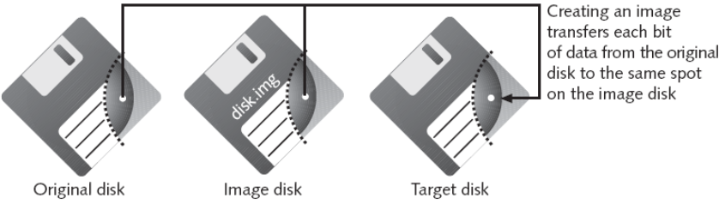
Understanding Bit-stream Copies (continued)
Copy image file to a target disk that matches the original disk’s manufacturer, size, and model

Slide 65
Acquiring an Image of Evidence Media
First rule of computer forensics
Preserve the original evidence
Conduct your analysis only on a copy of the data

Slide 66
Completing the Case

Slide 67
Completing the Case
You need to produce a final report
State what you did and what you found
Include report generated by your forensic tool to document your work
Repeatable findings
Repeat the steps and produce the same result, using different tools
If required, use a report template
Report should show conclusive evidence
Suspect did or did not commit a crime or violate a company policy

Slide 68



Associations & Bodies
American Academy of Forensic Sciences
The American Academy of Forensic Sciences is a society for forensics professionals, founded in 1948.
Forensic Science Society of Malaysia
To advance the study and application of forensic science
Organize meetings, lectures, discussions
To facilitate co-operation among persons who are, or have been, occupationally involved in forensic activities;
Digital: CyberSecurity Malaysia
Law enforcement agency in Malaysia

Slide 69
Q & A

